Slide 1
Three largest numbers
2023/02/02
Hailey

Slide 2
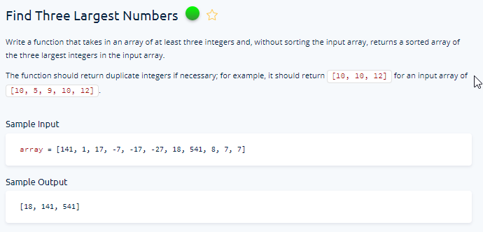

Slide 3
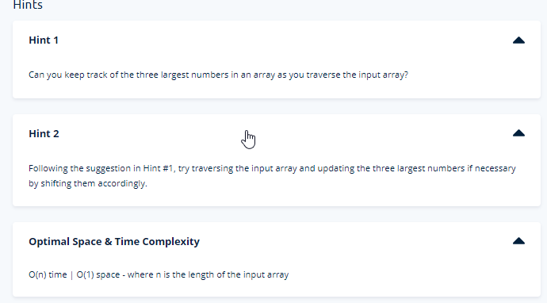

Slide 4
Steps
Find out the three largest numbers from the given list without using sort function.
Max function can filter out the largest number from the list.
Then, that value will be added to an empty list, which will later become the list that stores the three largest numbers.
By repeating this function for three time we can get our desired list.
Sorting the list
However, in current state the order is from the largest to the smallest..
In this case, we can apply sort function to sorted it from smallest to largest.

Slide 5
